Slide 1
Overview:
Rencana Penanggulangan Bencana di Rumah Sakit.
Hendro Wartatmo
Tim PMPK – FK UGM

Slide 2
Bencana di Rumah Sakit:
Situasi di RS dalam keadaan bencana:
  Kemampuan terlampaui ---- chaos ---- pelayanan sub standard
Rencana Penanggulangan Bencana di Rumah Sakit:
  Hospital Disaster Plan
Mengatur penanganan pasien yang jumlahnya banyak, saat bencana:
  Organization of Mass-Admission of Patients in the Hospital ( OMP )
Tujuan / target:
  Keadaan chaos sesingkat mungkin
  Mortalitas dan morbiditas serendah mungkin
  Distribusi pasien ke RS-RS merata
  Tidak meninggalkan pelayanan individu

Slide 3
Pelaksanaan:
Bekerja semaksimal mungkin dengan meningkatkan daya kemampuan
Tidak meninggalkan prinsip penanganan individual
Melanjutkan penanganan pasien yg sudah ada di RS sebelemnya
Mengatasi problem non medis akibat bencana
Mendukung pelayanan di area bencana.

Slide 4
Prinsip RPB-RS
Bukan sekedar eskalasi / peringatan dini
Based on existing organizational structures
( supaya pelayanan rutin tdk terganggu )
As simple as possible, as comprehensive as necessary
OMP fro preparedness, Check-list during emergency

Slide 5
Prinsip organisasi
Bukan sekedar eskalasi / peringatan dini
Ramping
Pelimpahan wewenang yang cepat
Markas yg sudah disiapkan berserta pendukungnya
Siapkan fasilitas – protap – personil sesuai rencana
Collapsable Concept

Slide 6
Organisasi PB-RS:
Coordination Team
Medical
Coordinator
Senior
Manager
Senior
Nurse
Senior
Emergency
Physician

Slide 7
Organisasi PB RS Tipe D / Puskesmas Ranap
Ketua Tim
Medis
Seksi Administrasi
Seksi
Keperawatan
Seksi
Medis
Operator
telpon
Pekarya
Dokter Gadar /
Spesialis
Laboratorium
Ranap
UGD

Slide 8
Senior Manager
Operation
Management
Suport
Facilities
Senior
Telephonist
Press
Officer
Senior
Porter
Senior
Transport
Manger
Senior
Enquiries
Officer
Senior
Security
Manager
Senior
Admissions
Officer
Volunteer
Coordinator
Religious
Officer
Senior
Social
Worker
Creche
Manager
Medical
Photographer
Senior
Engineer
Senior
Catering
Manager
TSSU
Manager
CSSU
Manager
Senior
Supplies
Manager
Linen
Service
Manager
The Management Hierarchy

Slide 9
Medical
Coordinator
Medical Support
Services
Senior
Emergency
Physician
Consultan
Haemato-logist
Consultan
Biochemist
Senior
MLSO
Consultan
Pathologist
Consultant
Psychiatrist
Consultan
Radiologist
House
Officers
Sub-Spciality
Consultants
SpRs
Senior
Phamacist
Senior
Surgeon
Senior
Physician
Surgical
Area
Senior
Radiographer
Radiologist
On-call
Senior
Intensivist
Senior
Paediatrician
MLSO
Biochemistry
MLSO
Haematology
MLSO
Transfusion
Duty
Radiographer
Senior
Surgeon
Theatres
Senior
Anaes
thetis
Senior
Surgeon
Pre-Op
Senior
Surgeon
Post-Op
Specialist
Operating
Teams
Operating
Teams
Trans-fer
Teams
P1 & P2
P3
Paediatric
Assessment
Teams
Treatment
Teams
Surgeon
Minors
Treatment
Teams
Physician
Minors
The Clinical Hierarchy

Slide 10
Senior Nurse
Senior Nurse
ED
Senior Nurse
Discharge Area
Senior Nurse
ITU
Senior Nurse
Theatres
Senior Nurse
Wards
Triage
Nurse
Senior
Nurse
P1 Resus
Senior
Nurse
P2
Senior
Nurse
P3
Team
Coordinator
ITU
Nurses
Senior ODP/
Anaesthetic
Nurse
Theatre
Nurse
Senior
Nurse
Admissions
Wards
Senior
Nurse
Paediatrics
Senior
Nurse
Pre-Op
Senior
Nurse
Post-Op
Treatment
Team
Nurses
P1
Treatment
Team
Nurses
P2
Treatment
Team
Nurses
P3
Anaesthetic
Nurses/
ODPs
The Nursing Hierarchy
Harus ada
Pengembangan
1
Pengembangan 2

Slide 11
Organisasi PB-RS
DIREKTUR
RS
Laiason
Officer
Ketua Tim
Menejemen
RS
Koordinator
Paramedis
Koordinator
Medis
Pelaksana / eksekutor
Bertanggung jawab ke Direktur
Profesional / mandiri / self generating
Bertanggung jawab ke ketua tim

Slide 12
Organisasi PB-RS
Ka UGD
( Dokter Jaga Bedah
KaBid Pelayanan
( Case Manager )
Logistik
Tehnik
KaBid Perawatan
( KaRu UGD )
Perawat ICU
Perawat OK
KaBid YanMed
( Dokter Jaga UGD )
Bedah
Anestesib

Slide 13
Organisasi PB-RS
Ka UGD
( Dokter Jaga Bedah
KaBid
Pelayanan
( Case Manager )
Logistik
Tehnik
Relawan
Komunikasi
KaBid
Perawatan
( KaRu UGD )
Perawat ICU
Perawat OK
KaBid
YanMed
( Dr Jaga UGD )
Bedah
OK
UGD
Anestesi
Tim
Lapangan
Penunjang
Medis
Lab.
Radiologi

Slide 14
Prosedur tetap
Rapid Health Assessement
Peringatan dini
Aktivasi
Pelaporan
Standar SDM
Hazard maping
Networking
Koordinasi relawan
Koordinator
Bidang
Menejemen
Bidang
Keperawatan
Bidang
Medis
Pengaturan Media
Menejemen relawan
Logistik medis
Komunikasi
Cadangan listrik
Logistik team
Transportasi
Rekruitmen tim
Persiapan OK
Persiapan Triase
Rekruitmen tim
Triase
Area cadangan
Rujukan

Slide 15
Standar Pelatihan
Koordinator
Bidang
Menejemen
Bidang
Keperawatan
Bidang
Medis
Disaster Management Incident Commander
HOPE
HOPE
Komunikasi medik
Menejemen logistik
Struktur gedung
PPGD
Perawat ICU
Perawat OK
Komunikasi medik
Ekstrikasi
ATLS
ACLC
First reponder

Slide 16
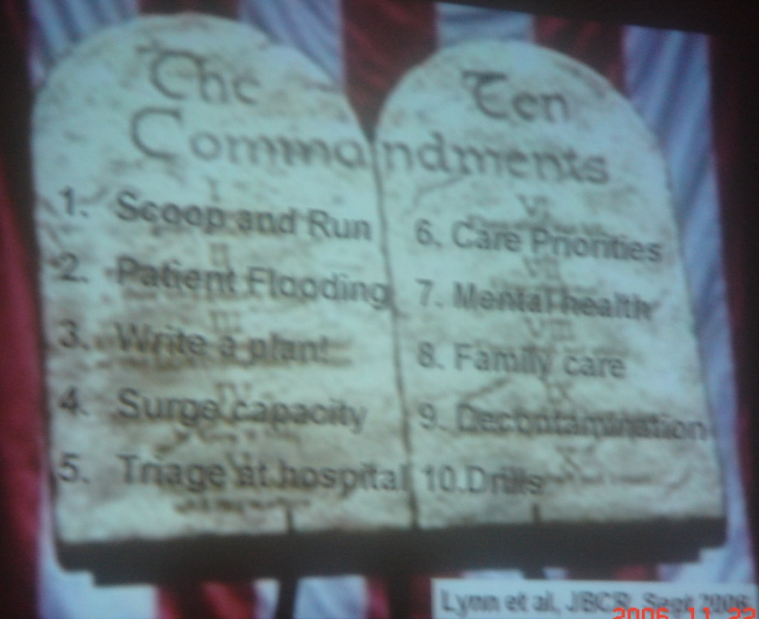
The Ten Commandments
Scope and Run
Patient flooding
Write plant
Surge capacity
Triage at Hospital
Care Priorities
Mental Health
Family care
Decontamination
Drill

Slide 17
Conclussion
HDP for every Hospital
Response is Function of Preparedness
Networking

